Slide 1
Shivajirao Kadam Institute of Technology and Management-Technical Campus, Indore
Department of Computer Science and Engineering
Minor Project-1 System Analysis and Design Presentation
On
“Job Board”
Guided By:- Presented By:-
Prof. Virendra Dani Rohan Raikwar(0875CS181122)
Tarun Chandel(0875CS181142)
Vishal Dangi(0875CS181147)
Vishesh Parmar(0875CS181149)

Slide 2
Introduction
This Project is aimed at developing an online application for the placement. The system is an online application that can be accessed throughout the organization and outside as well with proper login provided.
Students Logging should be able to upload their information in the form of a CV. Visitors/Company representatives logging in may also access/search any information up by students.

Slide 3
Problem Statement
The objects and functionalities in the system aim at making the placement process organized so that maximum productivity is ensured and there are minimal redundancies. The objective is to make sure that the interaction b/w different objects is easy as well as transparent. Best effort is made to make the website more interactive and user friendly than previous versions. Some new features like providing material to students for prepration are added to ensure smooth functioning of the application.

Slide 4
Suggested Solution
we are providing content of placement cell and job alert to the student. It will reduce the paper work and utilize the maximum capabilities of the setup and organization as well as it will save time and money which are spending in making reports and collecting data. It can be accessed throughout the organization with proper login provided.

Slide 5
Functional Requirements:-
Student Login: To make sure that only valid registered students have access to the website. Encryption and Decryption are used to ensure security. Client side and server side validations are being performed.
1.1) Forgot Password: To help students in case they forget their username Or password. Students are required to provide their mail id ,date of birth as well as registered mobile number. If all the credentials are valid then the students is provided with a link to update his/her password.
2) Update Resume: This provides students the facility to upload and update their resume. The student must be upload resume in pdf format. Necessary instructions are provides in the help section of the website. The application gives an error and notifies that the format is different from the given format.
3) Register: Students may register for a company visiting the campus on a specified date. Specific time duration is provided and students need to register in that given time frame. Otherwise he is not eligible to sit for that particular company.

Slide 6
Functional Requirements:-
4) View Company Profile: This functionality provides the students facility to have a look at various profiles for which company is hiring. This makes sure that student knows beforehand the requirements of the company and can prepare himself to face the interview.
5) View Company Details: Students get to know company related information like domain, eligibility criteria, policies etc. Based on the information a student can decide if he/she wants to register for the given company.
6) Contact Placement Cell: Students can shoot an email to placement cell representative in case they face a problem. If students have queries and suggestions during placement process they can get in touch with the placement cell easily.

Slide 7
Functional Requirements:-
7) Download Material: Students can download previous years papers and materials to prepare for placement. Focus is on providing latest technical and aptitude questions for placement. Focus is on providing latest technical and aptitude questions to keep students up to date with the latest placement procedures.
8) Admin Login: To make sure that only valid administrators can login with administrator rights.
9) Add Events: This is to facilitate administrators to post notification and add an event when company is about to visit the campus so that students can register for the company.
10) Approve Students: This is to make sure that only students who have registered and satisfy eligibility criteria can sit for placement.
11) Past Recruiters: Recruiters get know about the companies that are regular recruiters or the companies that have visited the campus in the past.

Slide 8
Non-Functional Requirements:-
Supportability: The application works fine on a wide range hardware platforms with proper internet connectivity and a popular internet browser. The applications is cross-platforms and responsive.
Response Time: The application is quite efficient when used with minimum specified hardware and software requirements. However higher the configuration, better the performance.
Security and Privacy: The application is built using J2EE. Thus application is secured as all the properties of java are inherited.
Error Handling: The system shall alert the users of errors consistent with java error handling. Backup of database can be taken to ensure application is in a stable state case of malfunctionality.

Slide 9
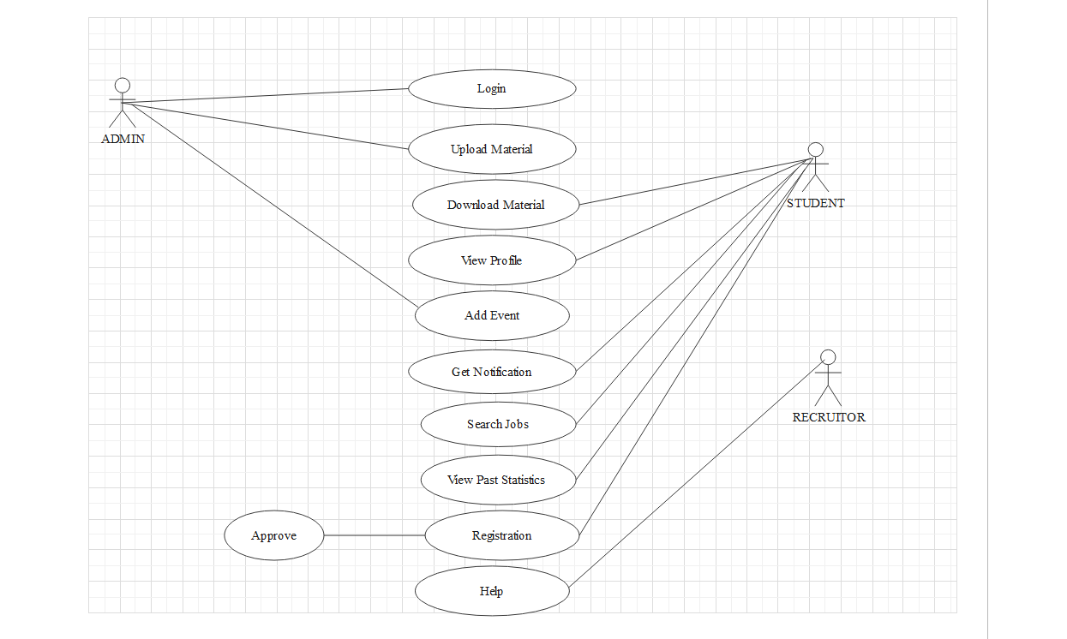
Use-Case Diagram:-

Slide 10
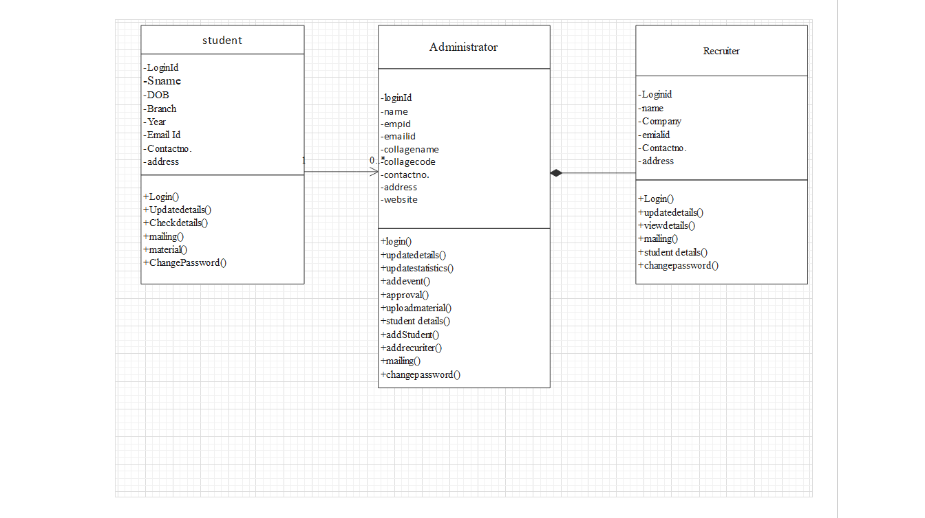
Class Diagram:-

Slide 11
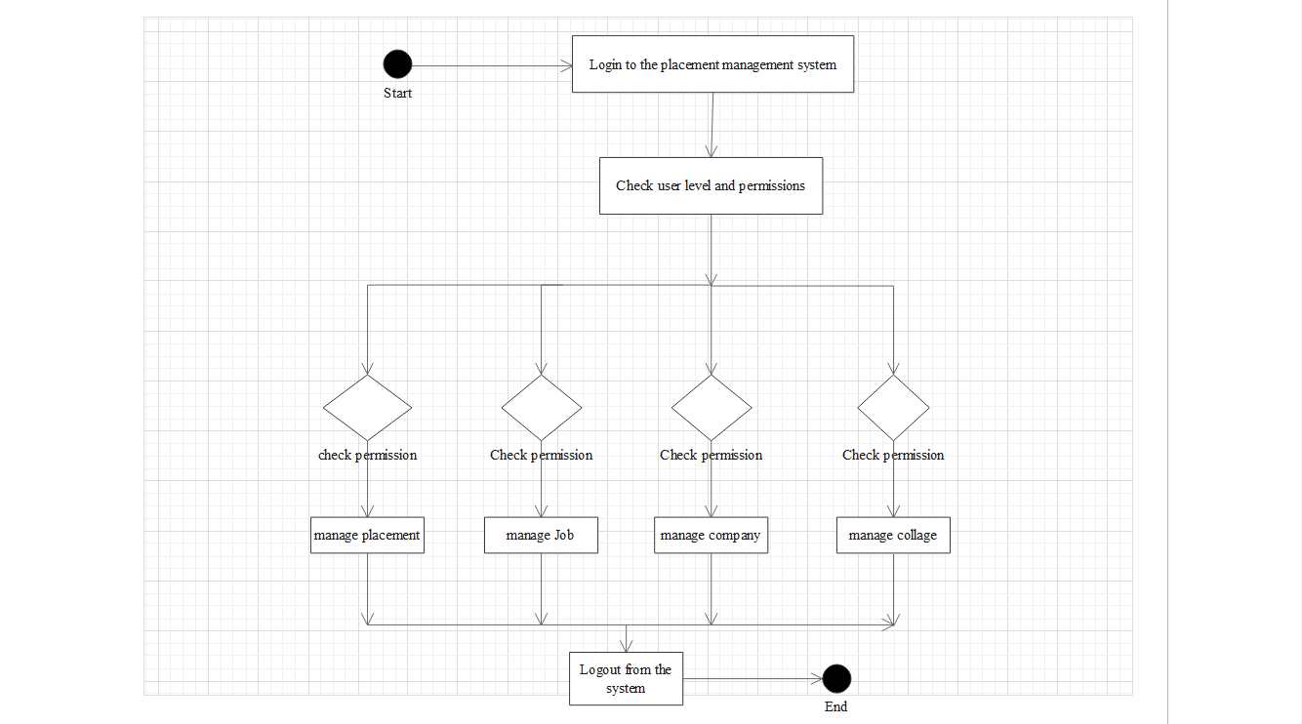
Activity Diagram:-

Slide 12
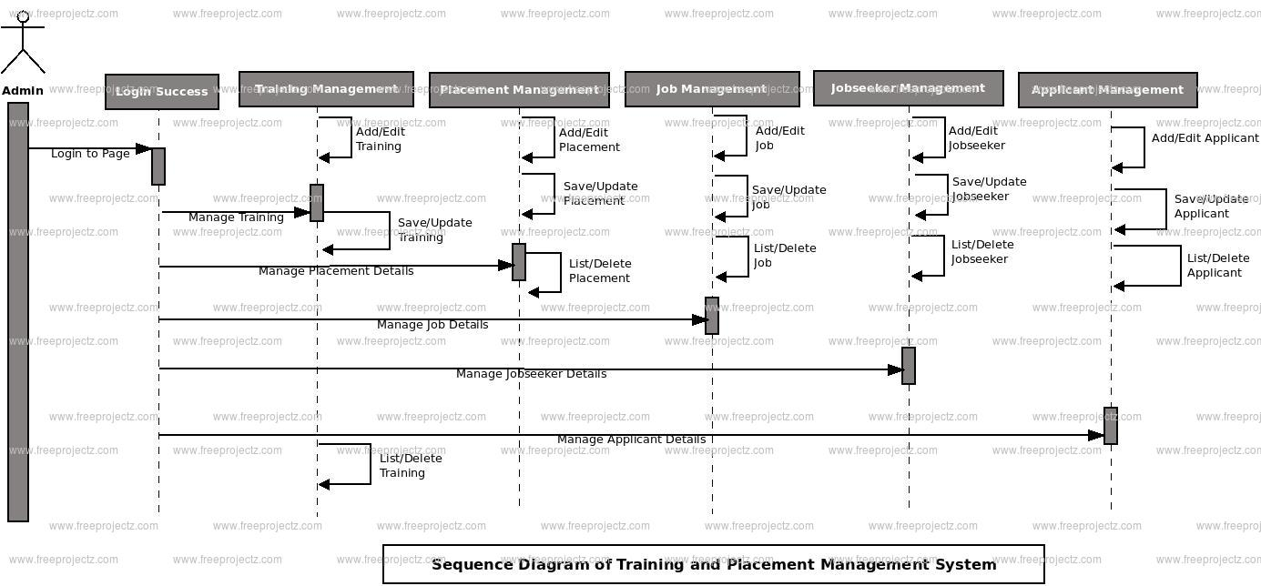
Sequence Diagram:-

Slide 13
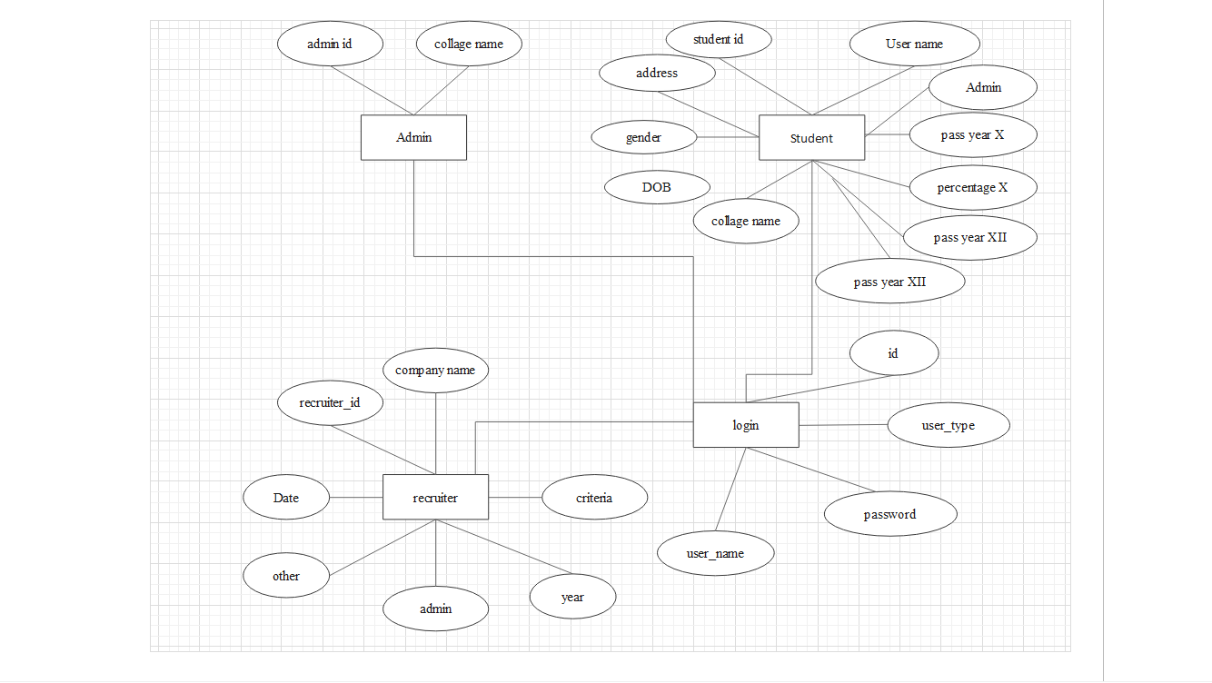
E-R Diagram:-

Slide 14
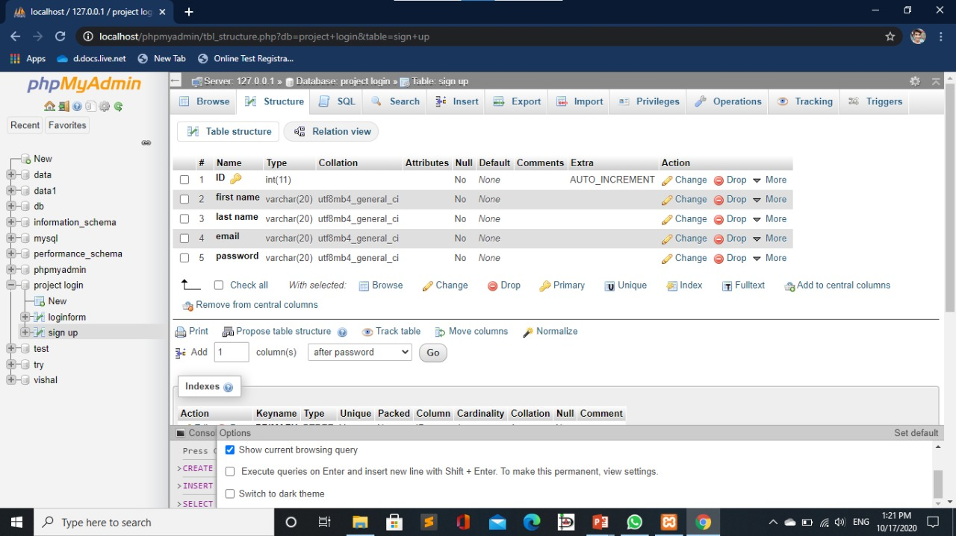
Database Table:-

Slide 15
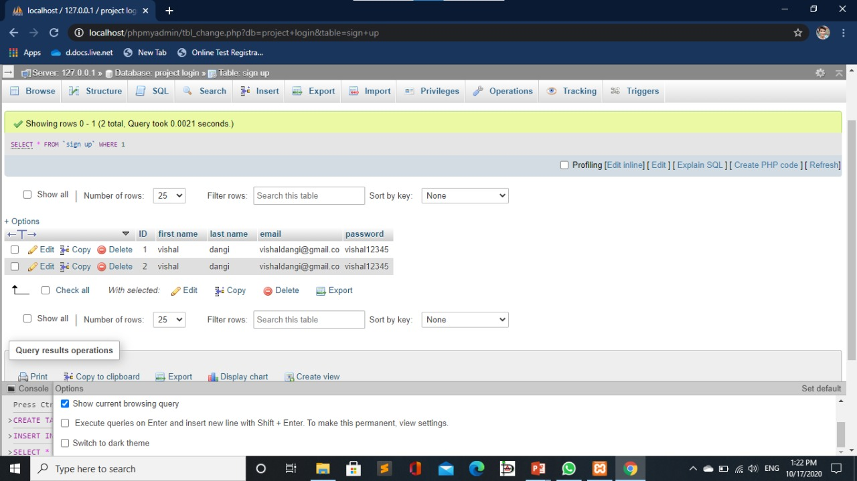
Database Table:-

Slide 16


